Slide 1
About Me

Slide 2
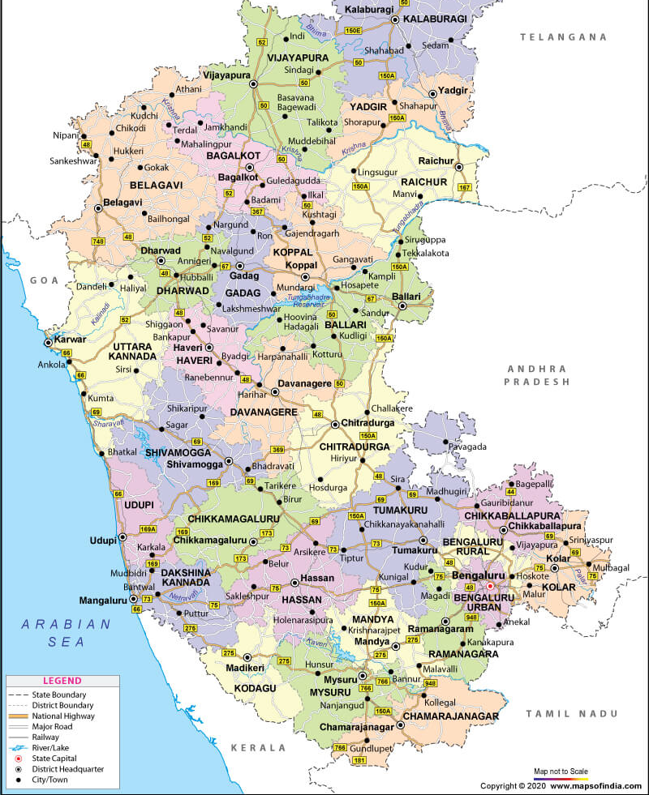
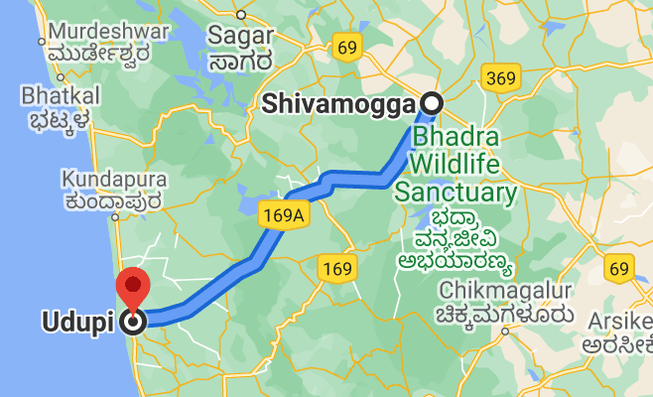
Born and brought up in Udupi
Completed my education in Shivamogga
Started my IT career in Bengaluru

Slide 3
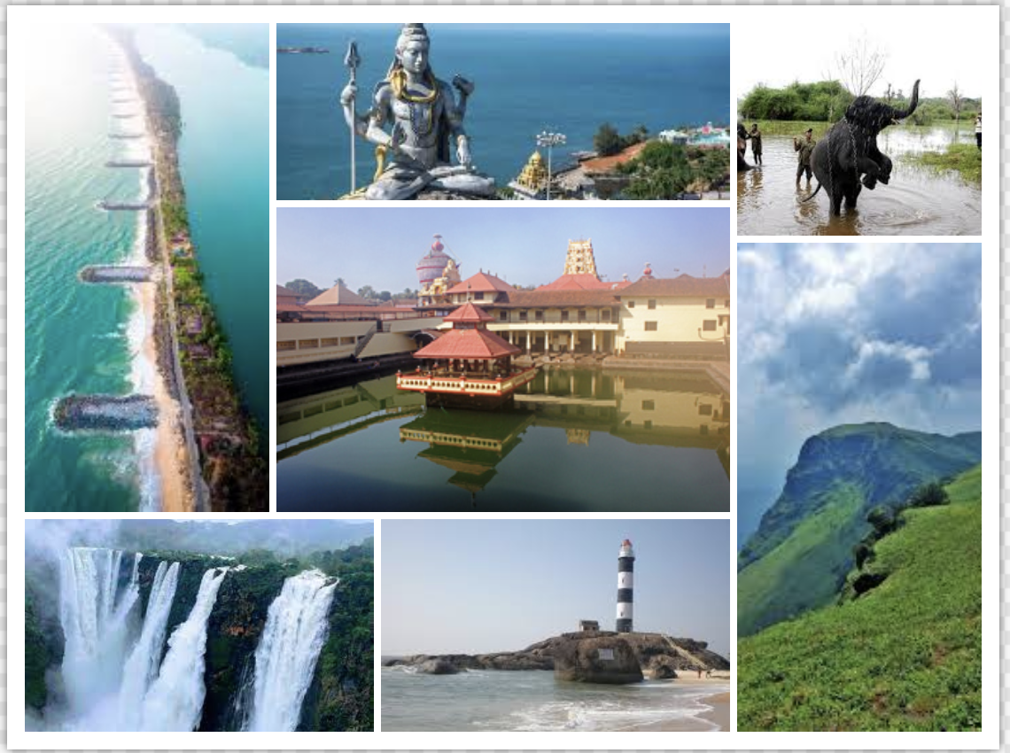
Few places from my hometown

Slide 4
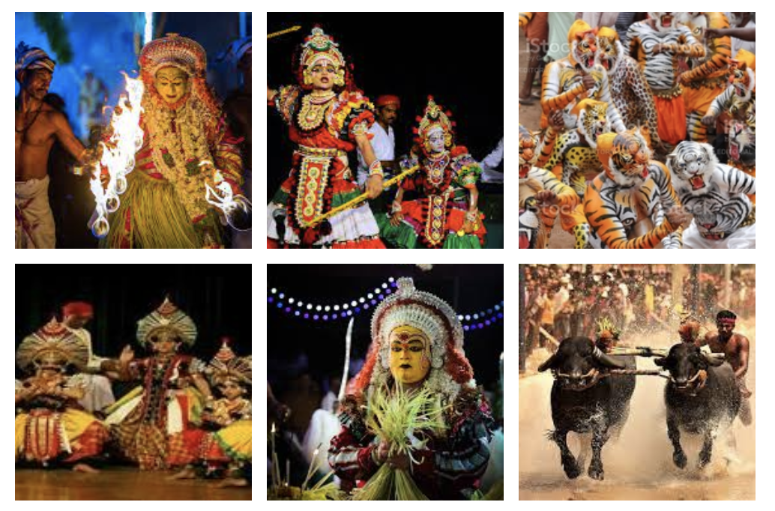
Cultures of my hometown

Slide 5
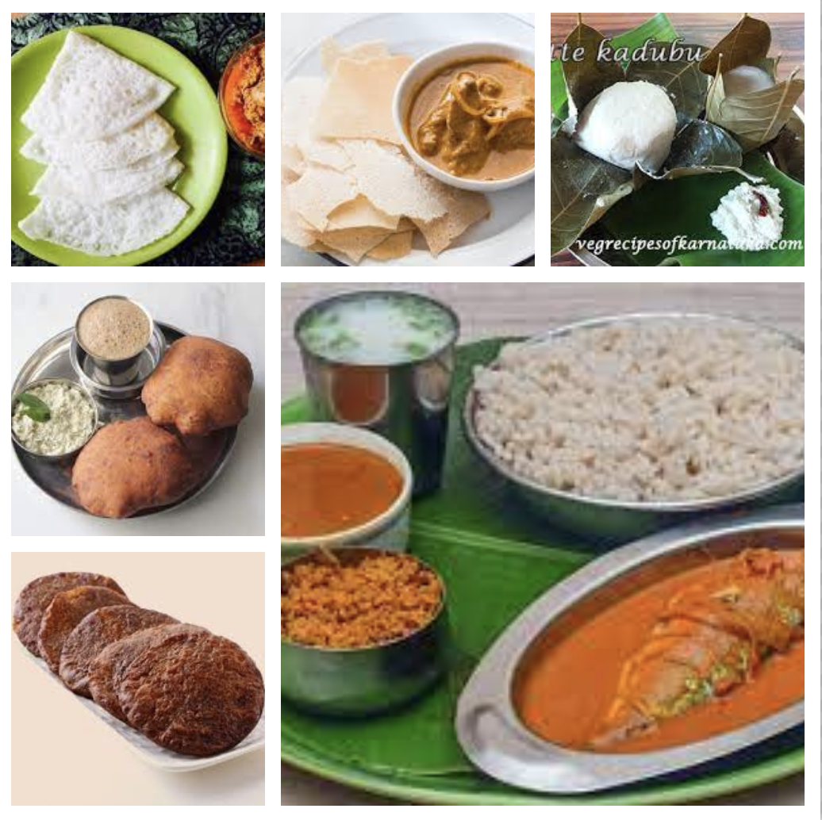
Authentic Udupi kitchen ☺

Slide 6
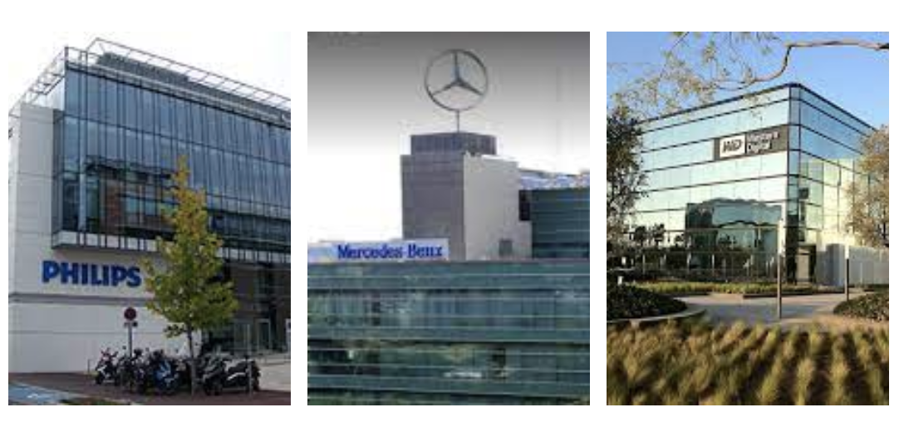
Ex-employers ☺

Slide 7
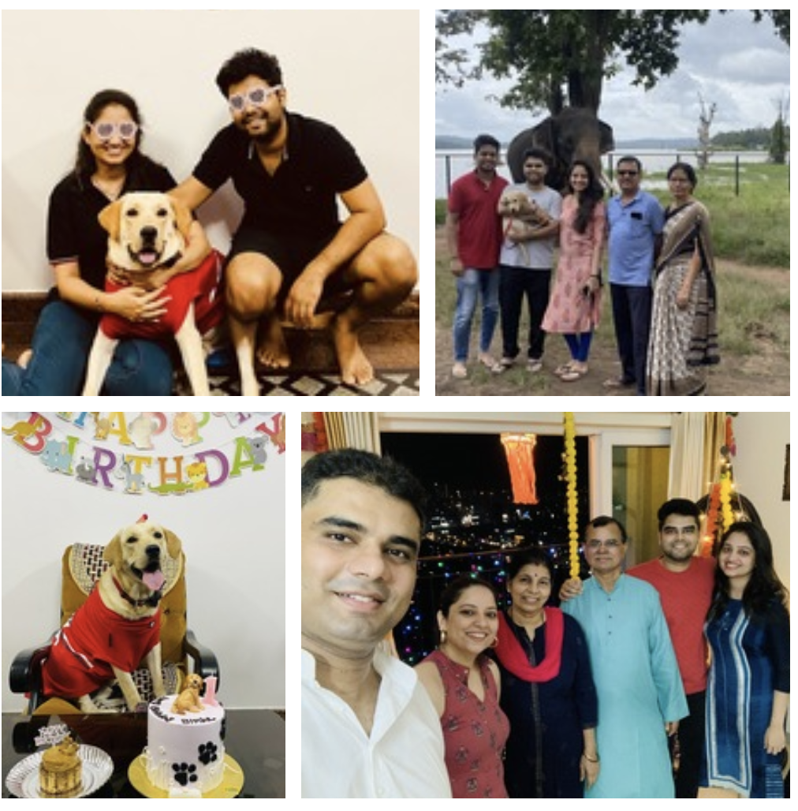
Family ☺

Slide 8
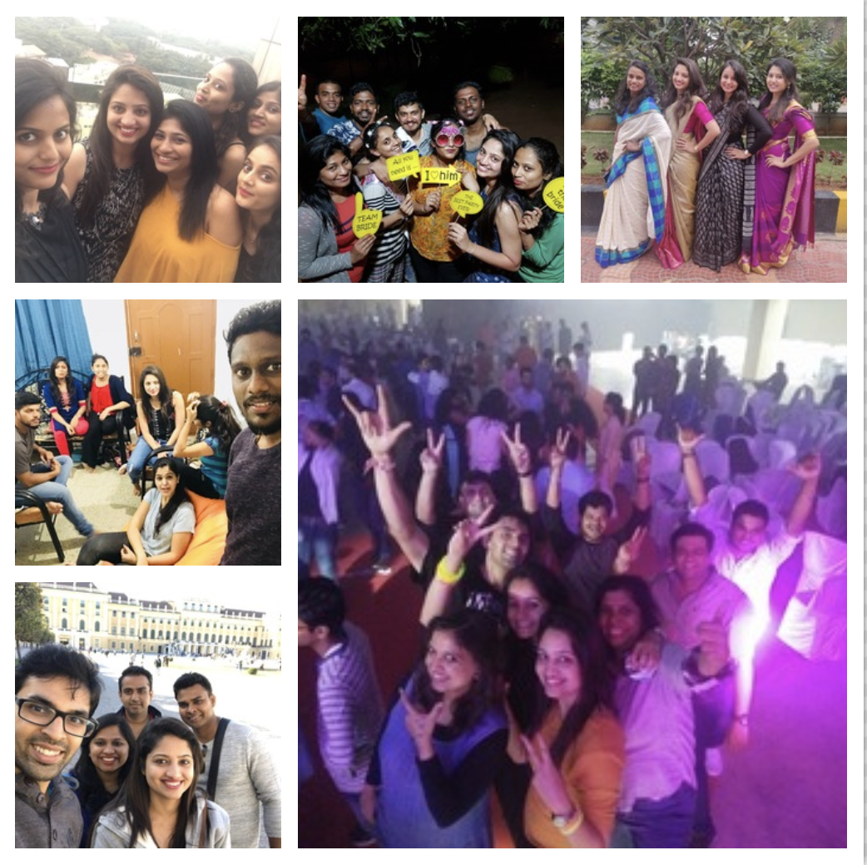
Friends and colleagues ☺

Slide 9
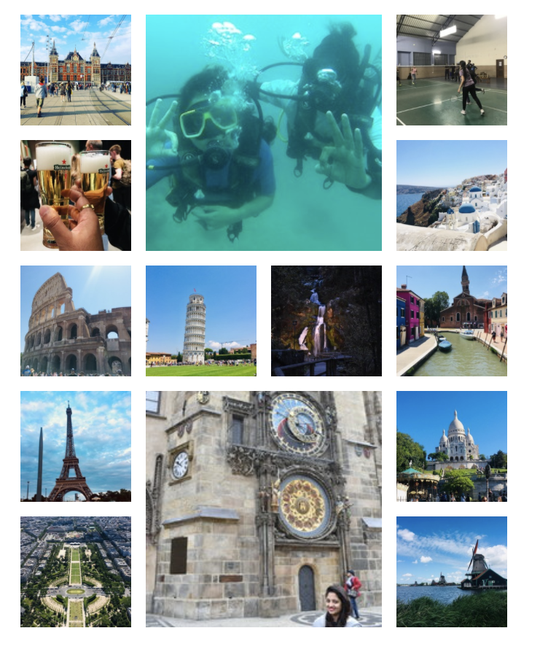
Hobby: - Travelling - Badminton

Slide 10

Thank You

